Slide 1
Week Three

Slide 2
Mindful Meditation
I can understand different meditation techniques
I will use meditation to deal with different situations

Slide 3
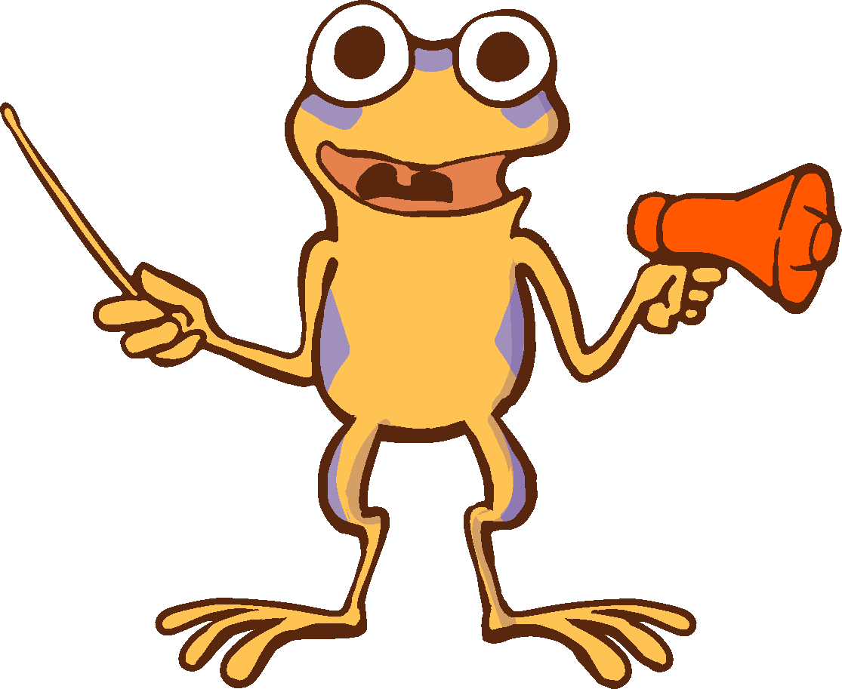
How has meditation effected your day-to-day life?
What do you use meditation to prepare for?

Slide 4
Today, we are going to focus on another type of meditation.
Mantra meditation
Find a positive mantra that inspires and calms you. When meditating, take a deep, full breath and when you release, either say or think this mantra and repeat it to yourself throughout the process. This meditation allows you to focus and feel empowered throughout the exercise. But remember to tell your family to not disturb you during this time. Someone barging into your room and screaming “WILL YOU BE QUIET” kind of kills the vibe.
This meditation will: Improves critical thinking, problem solving and reduces anxiety.

